Slide 1
Class 9
網路公開資訊的使用

Slide 2
📌政府公開資料平台網站簡介
📌CSV資料格式解析與應用
📌JSON資料格式解析與應用
📌公開資訊應用實例

Slide 3
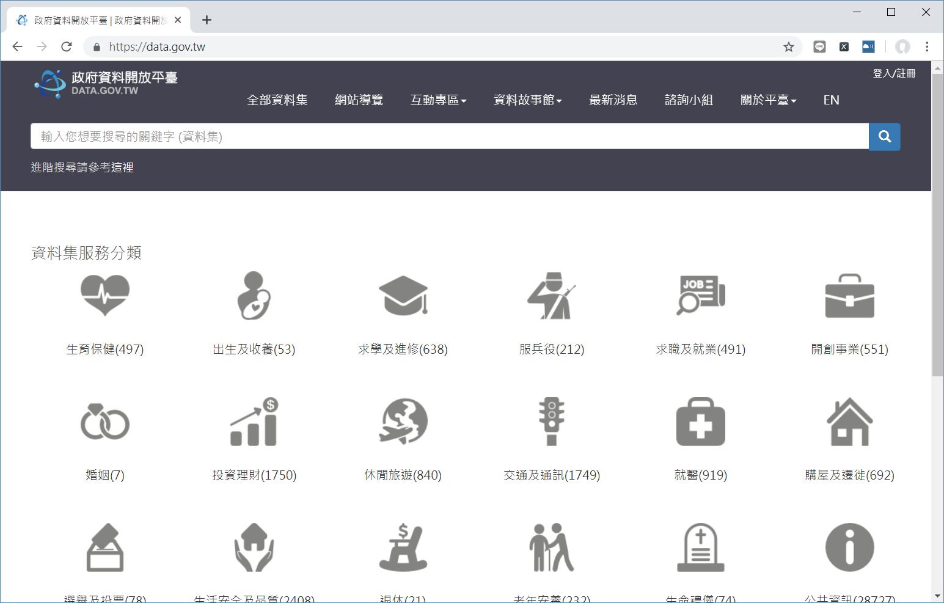
政府公開資料平台網站簡介
政府公開資訊平台首頁

Slide 4
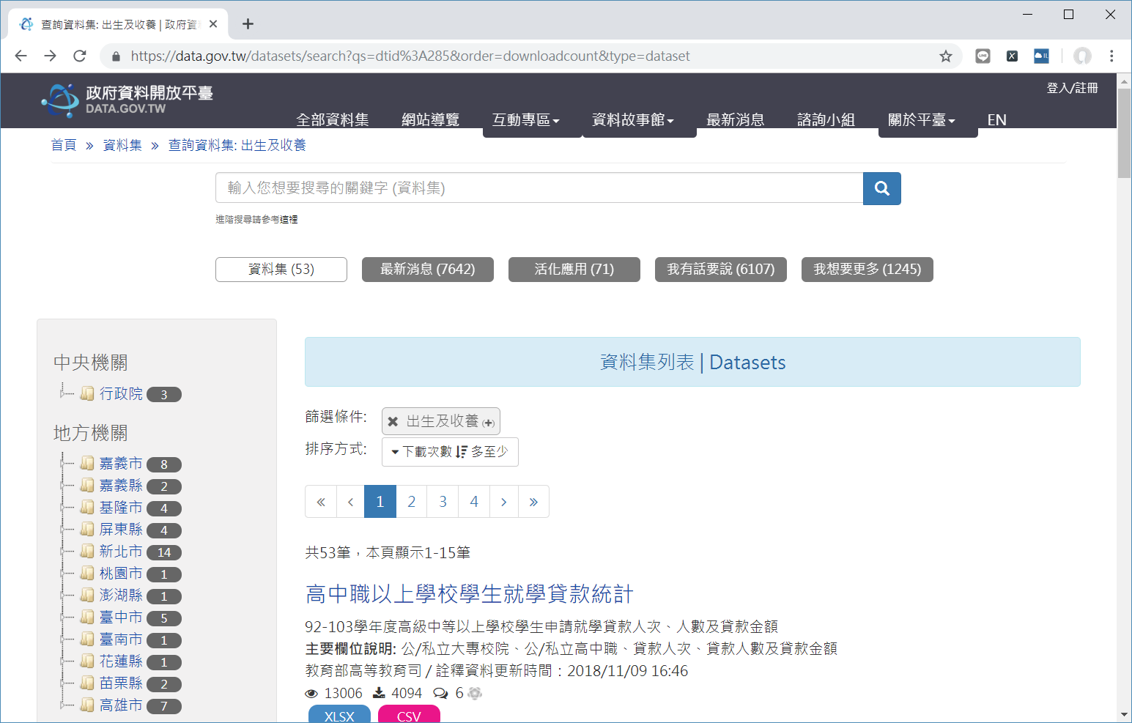
出生及收養分類內容頁面

Slide 5
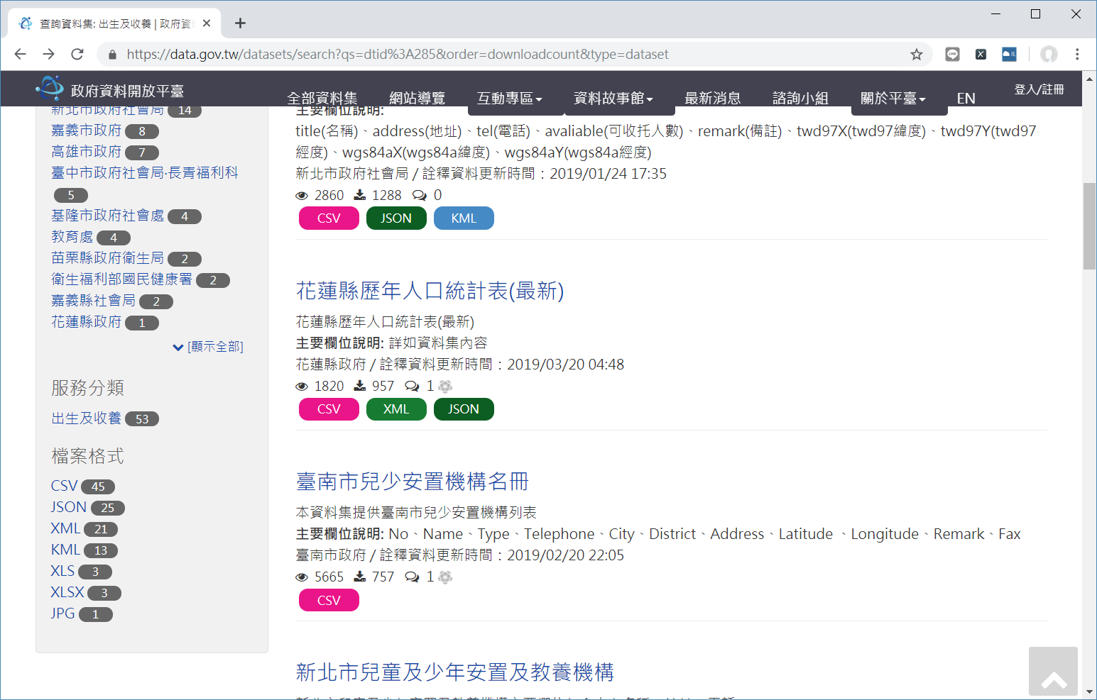
更多分類檢視項目

Slide 6
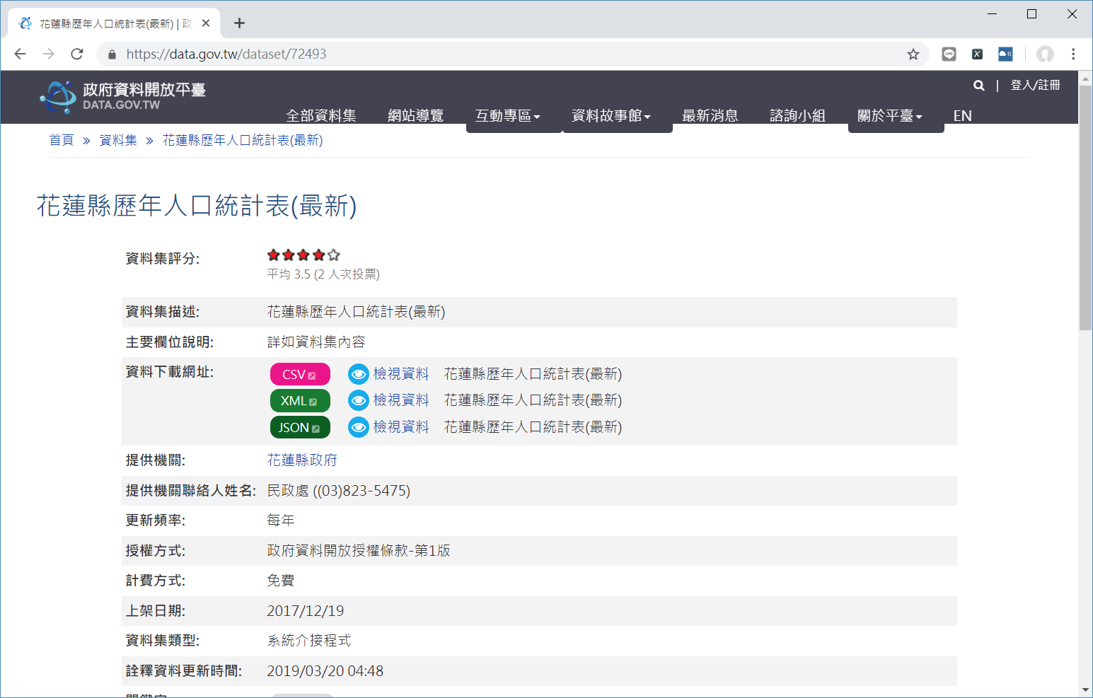
花蓮縣歷年人口統計表開放資料說明畫面

Slide 7
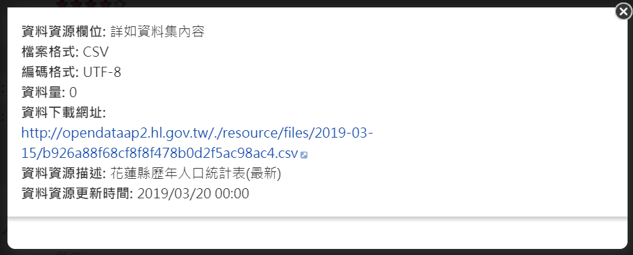
csv資料說明畫面

Slide 8
花蓮縣人口統計資料csv檔案內容
CSV資料格式解析與應用
序號,年度,總戶數,總人口數,男性人數,女性人數,平地原住民,山地原住民
1,91,109231,352154,185554,166600,54236,32520
2,92,110985,351146,184682,166464,59126,32669
3,93,112948,349149,183149,166000,53529,33105
4,94,114220,347298,181557,165741,55256,33575
5,95,115378,345303,180042,165261,55266,33860
6,96,116766,343302,178376,164926,55319,34028
7,97,118073,341433,177032,164404,55499,35199
8,98,119916,340964,176151,164813,55977,34627
9,99,120903,338805,174584,164221,56087,34842
10,100,121833,336838,173205,163653,56116,34903
11,101,122651,335190,172064,163126,55948,35028
12,102,123440,333897,171016,162881,55963,35159
13,103,124243,333392,170322,163068,56214,35461
14,104,124956,331945,169335,162610,56309,35690
15,105,125361,330911,168375,162536,56490,35989
16,106,125901,329374,167288,162086,56629,36107

Slide 9
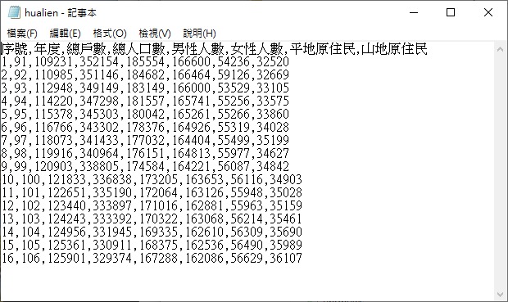
使用記事本開啟之後的外觀

Slide 10
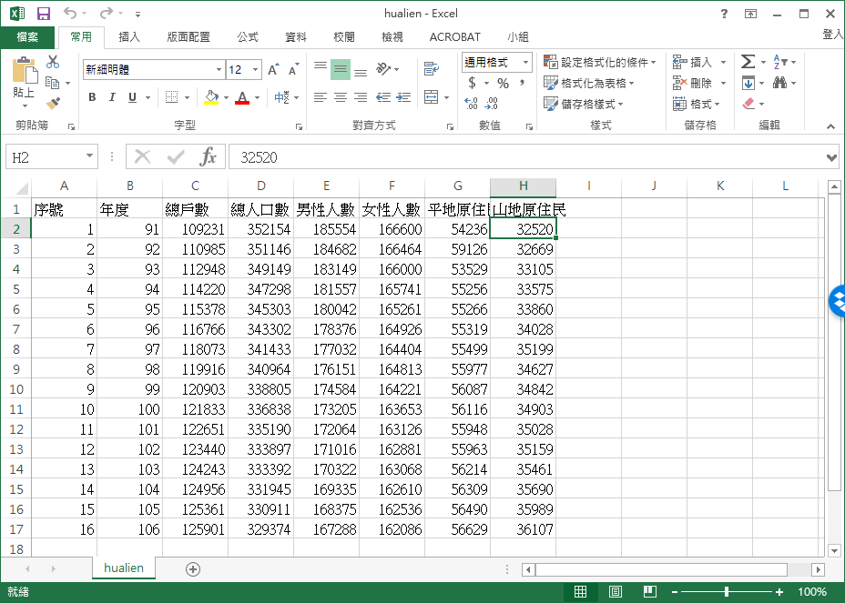
使用EXCEL開啟csv檔案之外觀

Slide 11
使用傳統的方式讀取csv檔案內容
filename = "hualien.csv"
data = list()
with open(filename, encoding='utf-8') as fp:
for line in fp.readlines():
data.append(list(line.split(",")))
print(data)

Slide 12
執行結果
[['\ufeff序號', '年度', '總戶數', '總人口數', '男性人數', '女性人數', '平地原住民', '山地原住民\n'], ['1', '91', '109231', '352154', '185554', '166600', '54236', '32520\n'], ['2', '92', '110985', '351146', '184682', '166464', '59126', '32669\n'], ['3', '93', '112948', '349149', '183149', '166000', '53529', '33105\n'], ['4', '94', '114220', '347298', '181557', '165741', '55256', '33575\n'], ['5', '95', '115378', '345303', '180042', '165261', '55266', '33860\n'], ['6', '96', '116766', '343302', '178376', '164926', '55319', '34028\n'], ['7', '97', '118073', '341433', '177032', '164404', '55499', '35199\n'], ['8', '98', '119916', '340964', '176151', '164813', '55977', '34627\n'], ['9', '99', '120903', '338805', '174584', '164221', '56087', '34842\n'], ['10', '100', '121833', '336838', '173205', '163653', '56116', '34903\n'], ['11', '101', '122651', '335190', '172064', '163126', '55948', '35028\n'], ['12', '102', '123440', '333897', '171016', '162881', '55963', '35159\n'], ['13', '103', '124243', '333392', '170322', '163068', '56214', '35461\n'], ['14', '104', '124956', '331945', '169335', '162610', '56309', '35690\n'], ['15', '105', '125361', '330911', '168375', '162536', '56490', '35989\n'], ['16', '106', '125901', '329374', '167288', '162086', '56629', '36107\n']]

Slide 13
取出串列資料項目的方法
年度 總人口數
91 352154
92 351146
93 349149
94 347298
95 345303
96 343302
97 341433
98 340964
99 338805
100 336838
101 335190
102 333897
103 333392
104 331945
105 330911
106 329374
filename = "hualien.csv"
data = list()
with open(filename, encoding='utf-8') as fp:
for line in fp.readlines():
data.append(list(line.split(",")))
for row in data:
print("{}\t{}".format(row[1], row[3]))

Slide 14
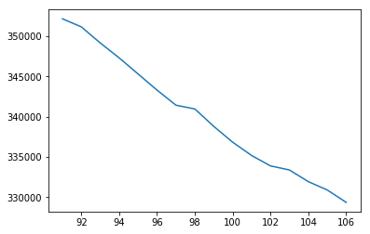
使用MATPLOTLIB 繪製圖表
%matplotlib inline
import matplotlib.pyplot as plt
filename = "hualien.csv"
data = list()
with open(filename, encoding='utf-8') as fp:
for line in fp.readlines():
data.append(list(line.split(",")))
x = [row[1] for row in data]
y = [row[3] for row in data]
plt.plot(x[1:], y[1:])

Slide 15
使用csv模組讀取csv檔案內容 （載入成為字典）
91 352154
92 351146
93 349149
94 347298
95 345303
96 343302
97 341433
98 340964
99 338805
100 336838
101 335190
102 333897
103 333392
104 331945
105 330911
106 329374
import csv
filename = "hualien.csv"
with open(filename, encoding='utf-8') as fp:
data = csv.DictReader(fp)
for item in data:
print(item['年度'],item['總人口數'])

Slide 16
使用csv模組讀取csv檔案內容 （載入成為串列）
import csv
filename = "hualien.csv"
with open(filename, encoding='utf-8') as fp:
data = csv.reader(fp)
for item in data:
print(item)
['\ufeff序號', '年度', '總戶數', '總人口數', '男性人數', '女性人數', '平地原住民', '山地原住民']
['1', '91', '109231', '352154', '185554', '166600', '54236', '32520']
['2', '92', '110985', '351146', '184682', '166464', '59126', '32669']
['3', '93', '112948', '349149', '183149', '166000', '53529', '33105']
['4', '94', '114220', '347298', '181557', '165741', '55256', '33575']
['5', '95', '115378', '345303', '180042', '165261', '55266', '33860']
['6', '96', '116766', '343302', '178376', '164926', '55319', '34028']
['7', '97', '118073', '341433', '177032', '164404', '55499', '35199']
['8', '98', '119916', '340964', '176151', '164813', '55977', '34627']
['9', '99', '120903', '338805', '174584', '164221', '56087', '34842']
['10', '100', '121833', '336838', '173205', '163653', '56116', '34903']
['11', '101', '122651', '335190', '172064', '163126', '55948', '35028']
['12', '102', '123440', '333897', '171016', '162881', '55963', '35159']
['13', '103', '124243', '333392', '170322', '163068', '56214', '35461']
['14', '104', '124956', '331945', '169335', '162610', '56309', '35690']
['15', '105', '125361', '330911', '168375', '162536', '56490', '35989']
['16', '106', '125901', '329374', '167288', '162086', '56629', '36107']

Slide 17
計算每戶平均人數
年度 每戶平均人數
91 3.22
92 3.16
93 3.09
94 3.04
95 2.99
96 2.94
97 2.89
98 2.84
99 2.80
100 2.76
101 2.73
102 2.70
103 2.68
104 2.66
105 2.64
106 2.62
import csv
filename = "hualien.csv"
with open(filename, encoding='utf-8') as fp:
data = csv.reader(fp)
print("年度\t每戶平均人數")
for item in data:
try:
print("{}\t{:.2f}".format(
item[1], int(item[3])/int(item[2])))
except:
pass

Slide 18
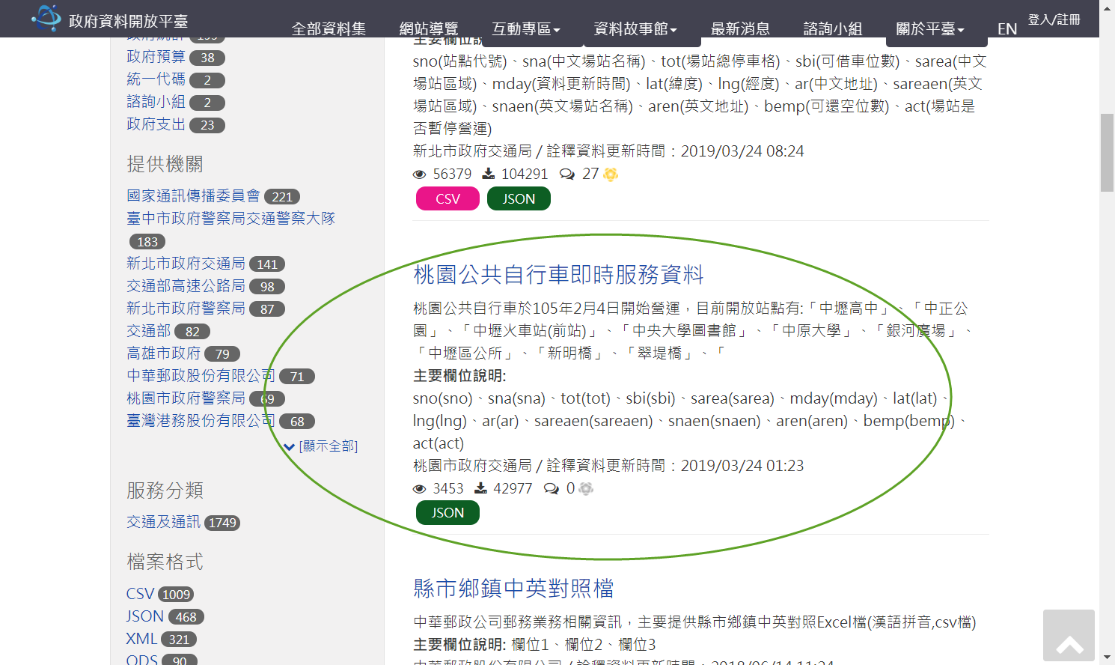
桃園市公共自行車即時服務資料
JSON資料格式解析與應用

Slide 19
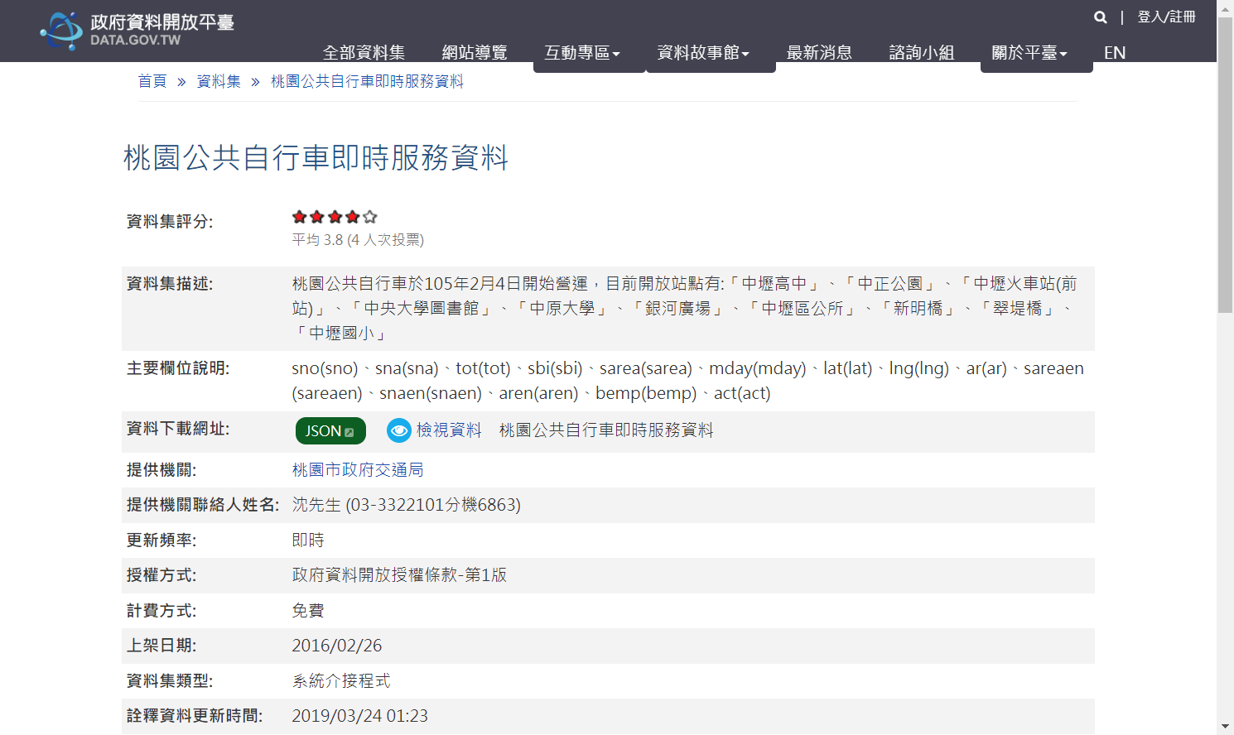
資料使用說明

Slide 20
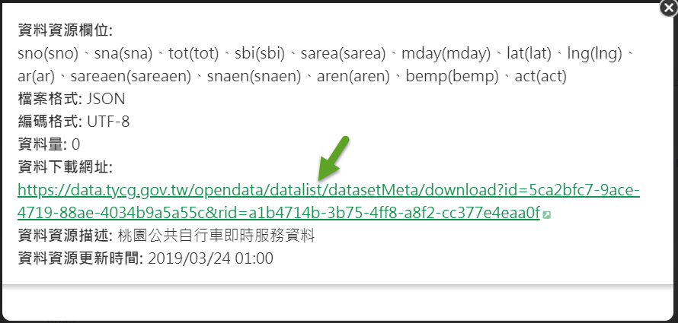
取得json檔案網址

Slide 21
透過網路讀取線上即時json檔案
import urllib.request, json
url = 'https://data.tycg.gov.tw/opendata/datalist/datasetMeta/download?id=5ca2bfc7-9ace-4719-88ae-4034b9a5a55c&rid=a1b4714b-3b75-4ff8-a8f2-cc377e4eaa0f'
with urllib.request.urlopen(url) as jsonfile:
data = json.loads(jsonfile.read().decode())
print(data)

Slide 22
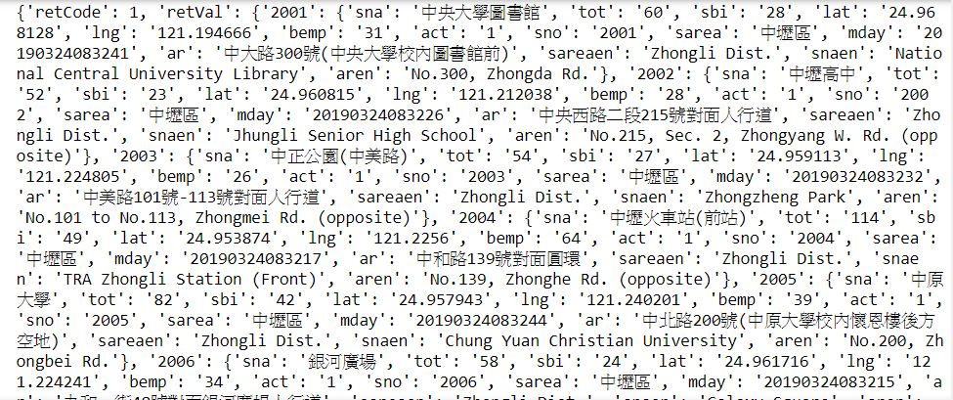
取得之部份結果

Slide 23
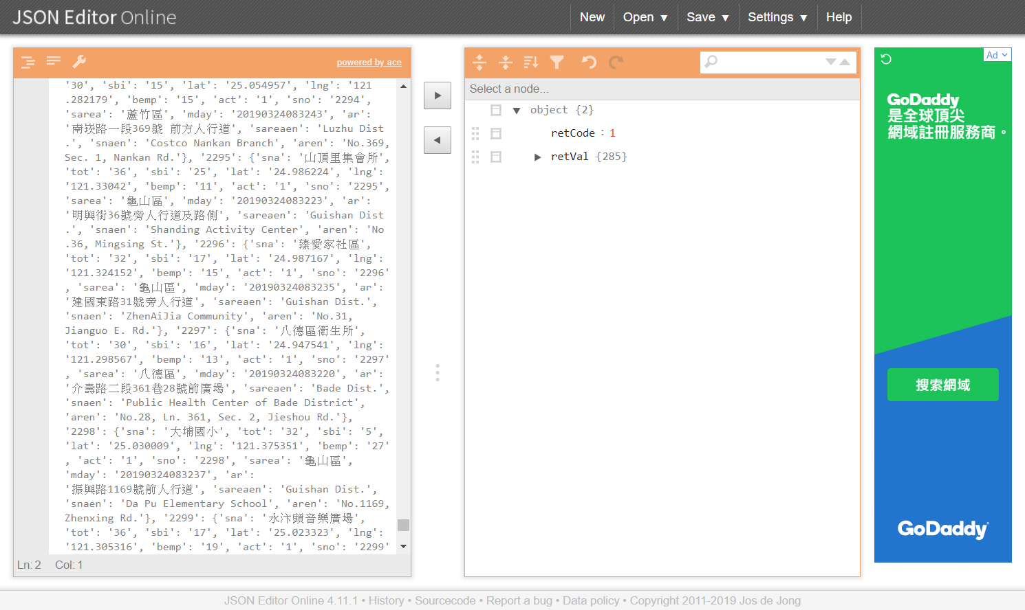
可使用json線上剖析器解析內容及結構

Slide 24
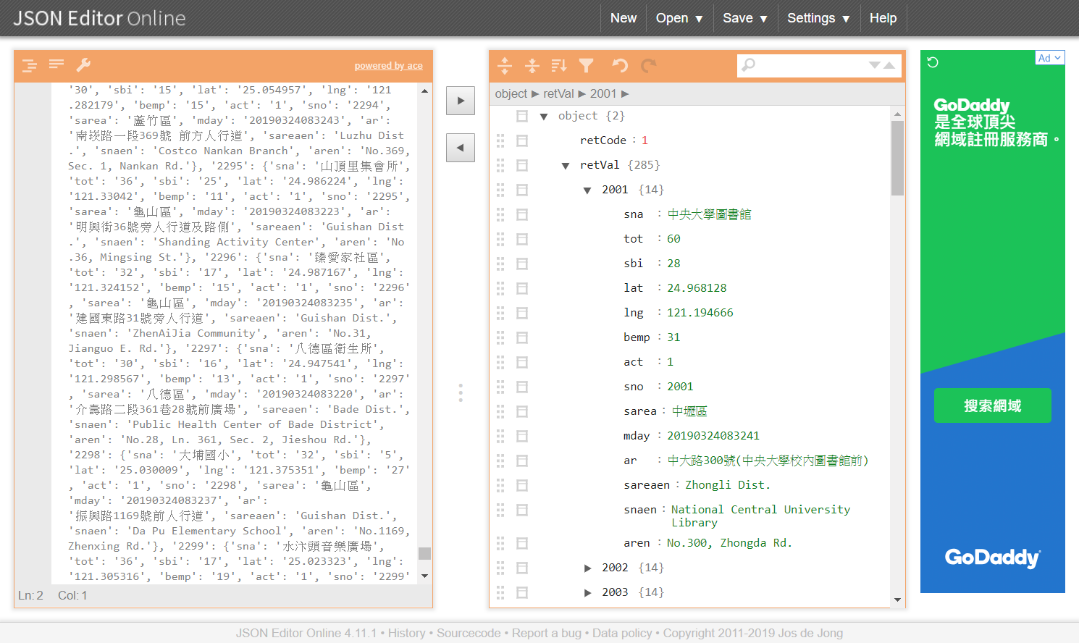
解析後呈現的樣子

Slide 25
即時顯示公共自行車可以租借的數量
import urllib.request, json
url = 'https://data.tycg.gov.tw/opendata/datalist/datasetMeta/download?id=5ca2bfc7-9ace-4719-88ae-4034b9a5a55c&rid=a1b4714b-3b75-4ff8-a8f2-cc377e4eaa0f'
with urllib.request.urlopen(url) as jsonfile:
data = json.loads(jsonfile.read().decode())
for k in data['retVal'].keys():
print("{:>2}/{:>2}\t{}".format(
data['retVal'][k]['sbi'],
data['retVal'][k]['tot'],
data['retVal'][k]['sna']))
28/60 中央大學圖書館
30/52 中壢高中
28/54 中正公園(中美路)
55/114 中壢火車站(前站)
24/82 中原大學
28/58 銀河廣場
18/40 中壢區公所
40/58 新明橋
12/46 翠堤橋
19/30 中壢國小
16/30 莒光公園
12/40 中壢火車站(後站)

Slide 26
使用迴圈顯示資料
公開資訊應用實例
for k in data['retVal'].keys():
print("{:>2}/{:>2}\t{}".format(
data['retVal'][k]['sbi'],
data['retVal'][k]['tot'],
data['retVal'][k]['sna‘]))

Slide 27
標準的HTML檔案架構
<!DOCTYPE html>
<html>
<head>
<title>My Title</title>
</head>
<body></body>
</html>

Slide 28
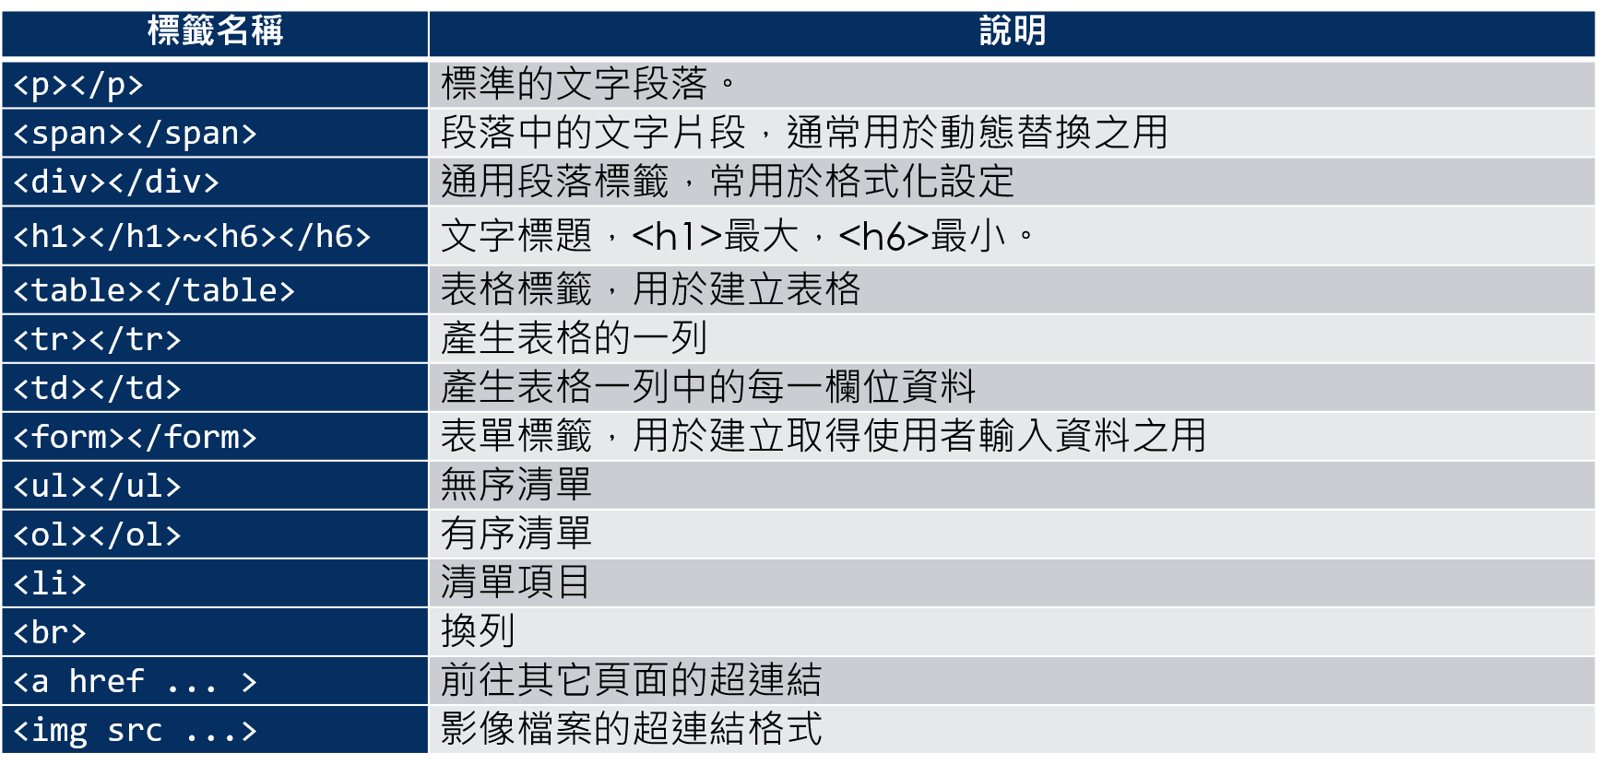
常用的HTML標籤摘要說明

Slide 29
利用即時資訊產生 HTML 檔案
import urllib.request, json
url = 'https://data.tycg.gov.tw/opendata/datalist/datasetMeta/download?id=5ca2bfc7-9ace-4719-88ae-4034b9a5a55c&rid=a1b4714b-3b75-4ff8-a8f2-cc377e4eaa0f'
with urllib.request.urlopen(url) as jsonfile:
data = json.loads(jsonfile.read().decode())
msg = "<table>"
for k in data['retVal'].keys():
msg += "<tr><td>{:>2}</td><td>{:>2}</td><td>{}</td></tr>".format(
data['retVal'][k]['sbi'],
data['retVal'][k]['tot'],
data['retVal'][k]['sna'])
msg += "</table>"
html = """
<!DOCTYPE html>
<html>
<head>
<title>{}</title>
</head>
<body>
{}
</body>
</html>
""".format("桃園公共自行車各站可租數量", msg)
with open("taoyouan-bike-v1.html", "wt", encoding='utf-8') as fp:
fp.write(html)
print("Done!")

Slide 30
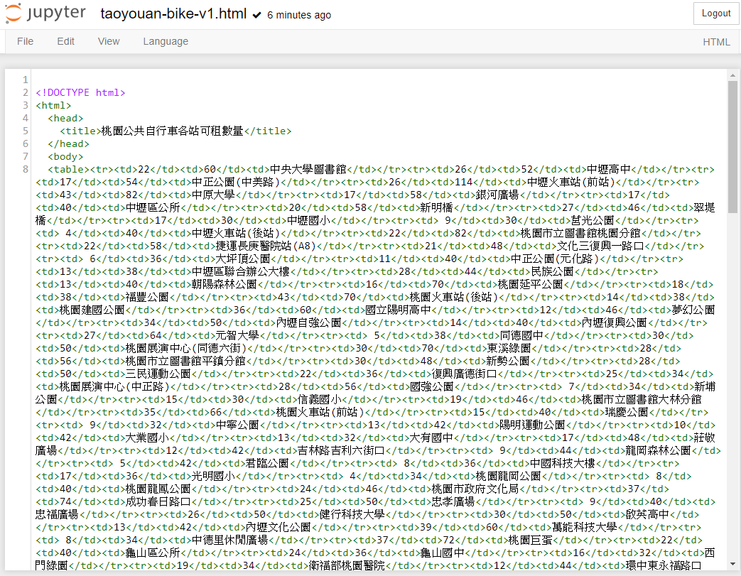
產生出來的原始檔案

Slide 31
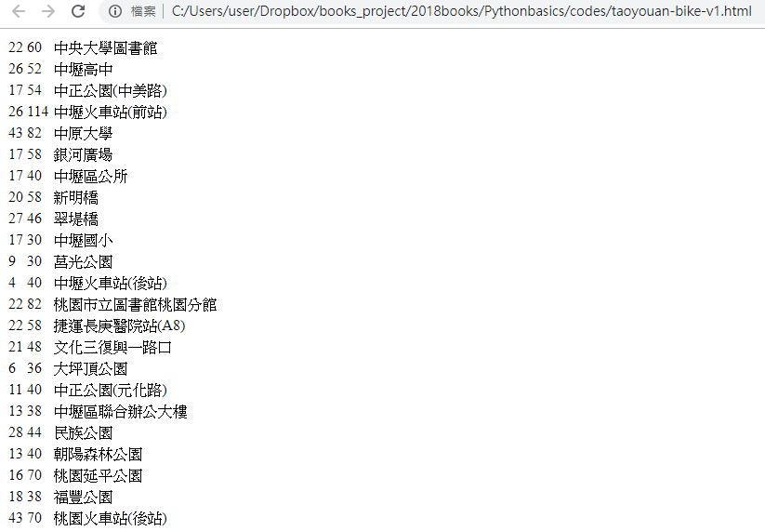
透過瀏覽器看起來的樣子

Slide 32
使用dominate模組產生標準HTML架構
<!DOCTYPE html>
<html>
<head>
<title>My Title</title>
</head>
<body></body>
</html>
from dominate import document
html = document("My Title")
print(html)

Slide 33
使用document模組 產生更多標籤
from dominate import document
from dominate.tags import *
html = document("桃園公共自行車各站可租數量")
with html.head:
meta(charset='utf-8')
with html.body:
h1("這是一個示範網頁")
hr()
p("這是一個段落")
p("這是另外一個段落，以下示範的是清單")
items = ul()
items += li("第一點")
items += li("這是第二點")
print(html)
<!DOCTYPE html>
<html>
<head>
<title>桃園公共自行車各站可租數量</title>
<meta charset="utf-8">
</head>
<body>
<h1>這是一個示範網頁</h1>
<hr>
<p>這是一個段落</p>
<p>這是另外一個段落，以下示範的是清單</p>
<ul>
<li>第一點</li>
<li>這是第二點</li>
</ul>
</body>
</html>

Slide 34
使用document模組 產生更多標籤(加上存檔）
from dominate import document
from dominate.tags import *
html = document("桃園公共自行車各站可租數量")
with html.head:
meta(charset='utf-8')
with html.body:
h1("這是一個示範網頁")
hr()
p("這是一個段落")
p("這是另外一個段落，以下示範的是清單")
items = ul()
items += li("第一點")
items += li("這是第二點")
with open("sample.html", "wt", encoding='utf-8') as fp:
fp.write(html)
print("Done!")

Slide 35
利用即時資訊產生 HTML 檔案 使用dominate模組
#以表格的方式呈現公共自行車租借站資訊
import dominate
from dominate.tags import *
import urllib.request, json
url = 'https://data.tycg.gov.tw/opendata/datalist/datasetMeta/download?id=5ca2bfc7-9ace-4719-88ae-4034b9a5a55c&rid=a1b4714b-3b75-4ff8-a8f2-cc377e4eaa0f'
with urllib.request.urlopen(url) as jsonfile:
data = json.loads(jsonfile.read().decode())
html = dominate.document(title="桃園公共自行車各站可租數量")
with html.head:
meta(charset="utf-8")
with html:
h1("桃園公共自行車各站可租數量")
hr()
with table():
head = tr(bgcolor='#888888')
head += td("站名")
head += td("可租數量")
head += td("自行車總量")
head += td("本站位置")
for index, k in enumerate(data['retVal'].keys()):
if index % 2 == 0:
row = tr(bgcolor='#ccffcc')
else:
row = tr(bgcolor='#ffccff')
row += td(data['retVal'][k]['sna'])
row += td(data['retVal'][k]['sbi'])
row += td(data['retVal'][k]['tot'])
row += td(data['retVal'][k]['ar'])
with open("taoyuan-bike-list.html", "wt", encoding='utf-8') as fp:
fp.write(str(html))
print("Done!")

Slide 36
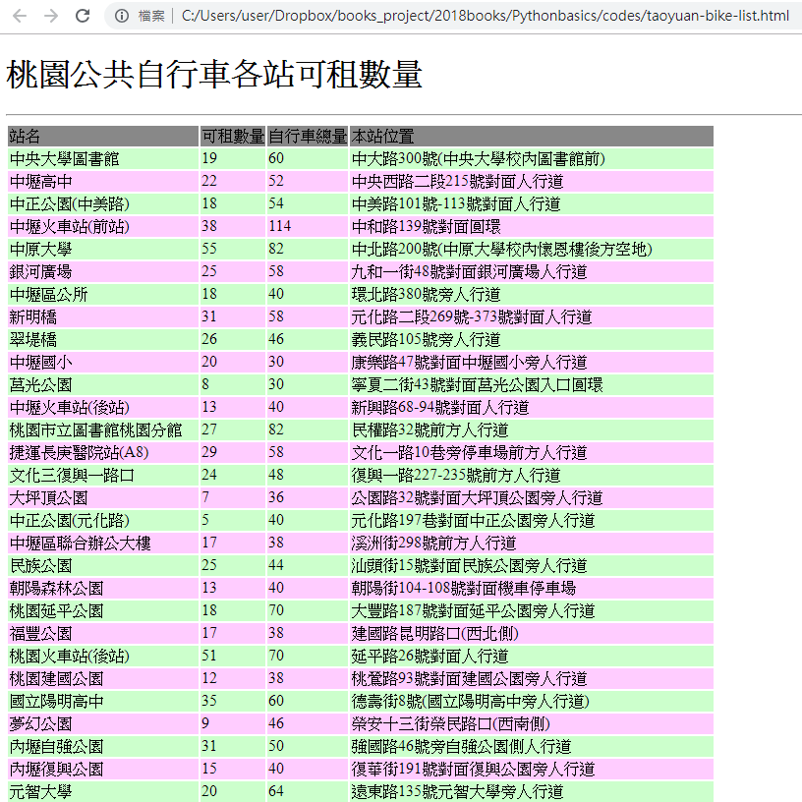
執行結果

Slide 37
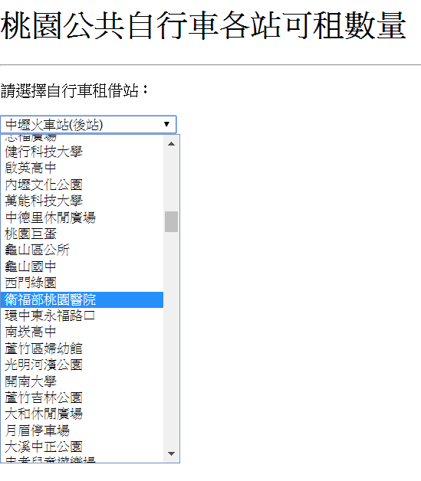
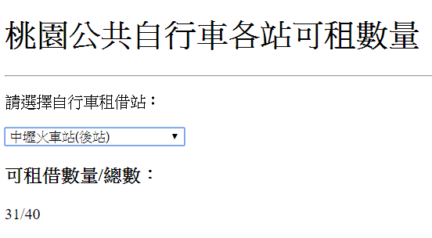
加上jquery程式庫的互動式介面 （程式請參考書上內容）

